Slide 1

AI Is Already Here!
Understanding the technology behind the tools you use
AI AWARENESS DAY – Assembly
#AIAWARENESSDAY26
Notes:
5

Slide 2
DID YOU KNOW?
AI DOESN'T 'KNOW' THINGS — IT PREDICTS WHAT WORD COMES NEXT
Large Language Models are trained on billions of web pages, books, and articles
They work by predicting the most likely next word based on patterns — not by understanding meaning
AI can confidently give wrong answers (called 'hallucinations')
this happens regularly
Source: MIT, Stanford AI Index 2025
#AIAWARENESSDAY26
Notes:
7

Slide 3
?
Have You Used Ai Today?
Unlocked your phone with Face ID?
Got a recommendation on YouTube or Spotify?
Used autocomplete or spell check?
Searched for something on Google?
Used ChatGPT, Siri, or Google Assistant?
Scrolled through TikTok or Instagram?
#AIAWARENESSDAY26
Notes:
6

Slide 4
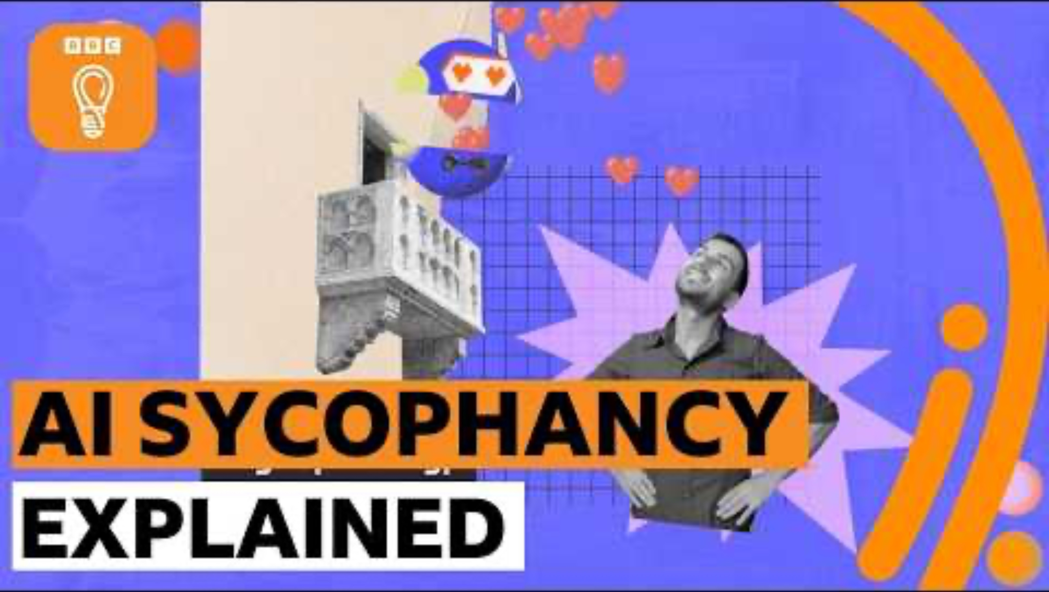
?
How Ai Actually Works
#AIAWARENESSDAY26
Notes:
6

Slide 5
Being AI-Smart
1
AI is a pattern-matching tool, not a thinking being — it doesn't 'know' facts
2
Always verify AI outputs with reliable sources — don't trust it blindly
3
AI reflects patterns in its training data, including biases and errors
4
Understanding HOW AI works helps you use it more effectively
5
The more specific your question, the better the output
💡 KEY TAKEAWAY: AI is a powerful tool, but like any tool, you need to know how to use it properly.
#AIAWARENESSDAY26
Notes:
8

Slide 6
REPORTING & SUPPORT RESOURCES
IF YOU ENCOUNTER INAPPROPRIATE CONTENT, OR ONLINE BULLYING:
YOUR TUTOR, HEAD OF YEAR, OR SAFEGUARDING LEAD IS AVAILABLE TO ASSIST YOU.
#AIAWARENESSDAY26
Notes:
4

Slide 7
REPORTING & SUPPORT RESOURCES
For Deepfake/Image-Based Abuse
CEOP (Child Exploitation and Online Protection):
ceop.police.uk/safety-centre
Mental Health Support Childline:
0800 1111
Young Minds:
youngminds.org.uk
Internet Watch Foundation:
report at iwf.org.uk
General Online Safety
UK Safer Internet Centre: saferinternet.org.uk
NSPCC:
nspcc.org.uk/keeping-children-safe/online-safety
ThinkUKnow:
thinkuknow.co.uk?
Childline:
0800 1111 or childline.org.uk
#AIAWARENESSDAY26
Notes:
4

